Slide 1
Causal Diagrams
DAGs for All!

Slide 2
Danielle Presgraves, Ph.D.
1st generation student & lifelong learner
I am from Vancouver Island
I have lived in four different countries
I love to tinker
I have held multiple non-academic jobs
I love to collaborate & facilitate
Notes:
I FAIL ALL THE TIME! Rarely have I been successful….
Even people you don’t like have something to teach you (Diversity might be important due to the fact that you have to explain your assumptions when you are working with people who aren’t like you…)
Red Queen to Alice:
“Alice laughed. 'There's no use trying,' she said. 'One can't believe impossible things.' I daresay you haven't had much practice,' said the Queen. 'When I was your age, I always did it for half-an-hour a day. Why, sometimes I've believed as many as six impossible things before breakfast. There goes the shawl again!”
― Lewis Carroll
1st Generation Student & Lifelong Learner
Emphasize clearly delineated milestones; I create pathways that reduce frustration and uncertainty for other people.
I collect hobbies & I love to tinker
Sewing, gardening, Ikea-furniture Hacker, Pilates etc
I am a natural collaborator & facilitator
I don’t have all knowledge; including the expertise of others improves outcomes for all.
I have a firm belief that understanding how to evaluate and communicate the uncertainty of data are the most important skills you can cultivate.
I have lived in four different countries
Culture is crucial to learning; not everyone will have the same values, background or shared metaphors so find your common mission. This is true in science, too.
I have held multiple non-academic jobs in my lifetime
This leads me to prioritize practical outcomes in my pedagogical endeavours.

Slide 3




University of Calgary
Mathematics
Cellular, Molecular, Microbial Biology
Harvard University
Ph.D. Biology – Theoretical population genetics
Cornell University
Computational Genomics, 1000 Genomes
University of Rochester
Associate Professor of Instruction
Statistics
Computational Biology, etc.
Notes:
2019: Advanced Certificate in Online Teaching
2022: Community Based Research Participation

Slide 4
Intro to Causal Diagrams
Why?
Why does “correlation ≠ causation”?
Impact and limitations on scientific inquiry?
How?
Causal Diagrams: basic concepts & application
What?
Summary
Additional Resources for Practice
4. Vision*

Slide 5
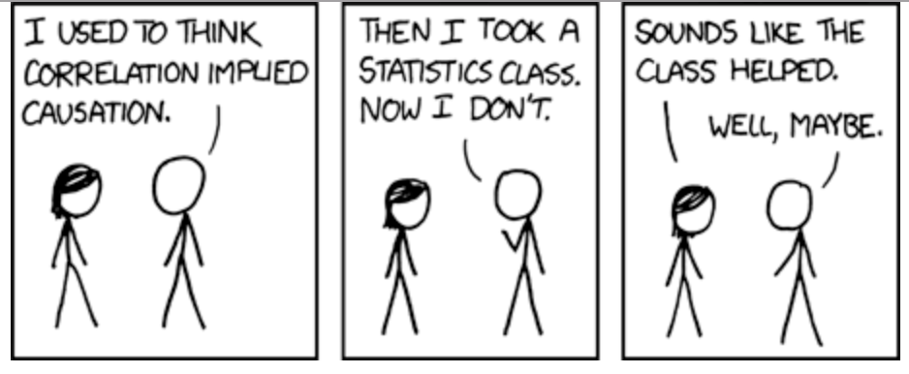
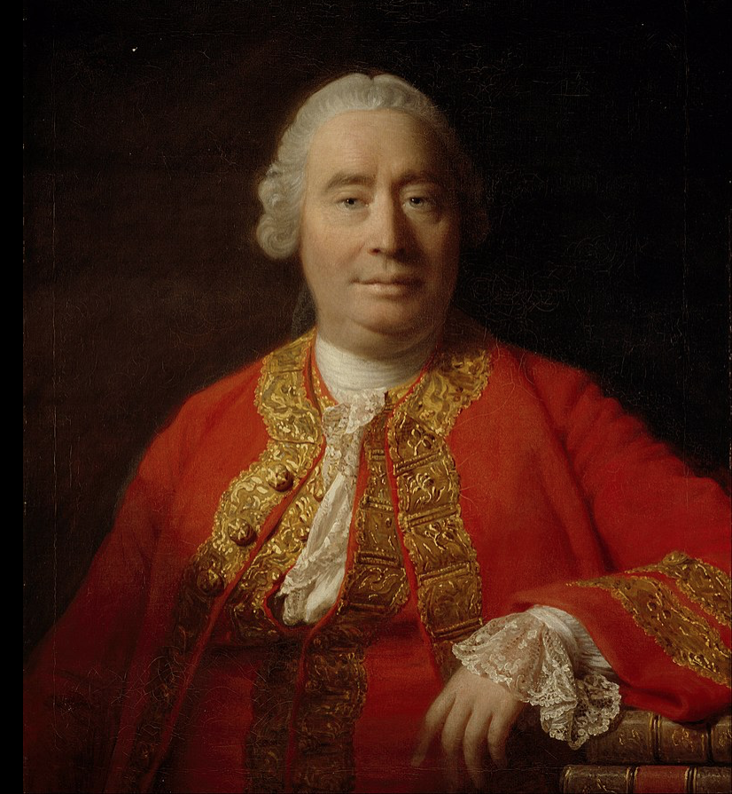
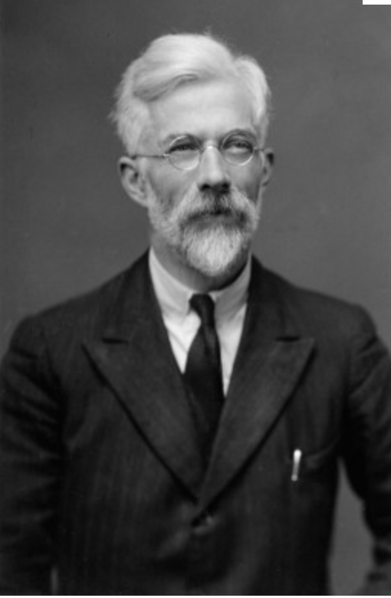
Why Correlation ≠ Causation
Notes:
Correlation doesn’t imply causation, but it does waggle its eyebrows suggestively and gesture furtively while mouthing “look over there”. – Randall Munroe
Fisher → Bayes methods (addressed problems that classical methods could not address)-→ Casual Analysis (addresses some of the challenges of the new type of complex data sets that we are dealing with – not just Latin squares!, but observational, heterogeneous and missing data!

Slide 6
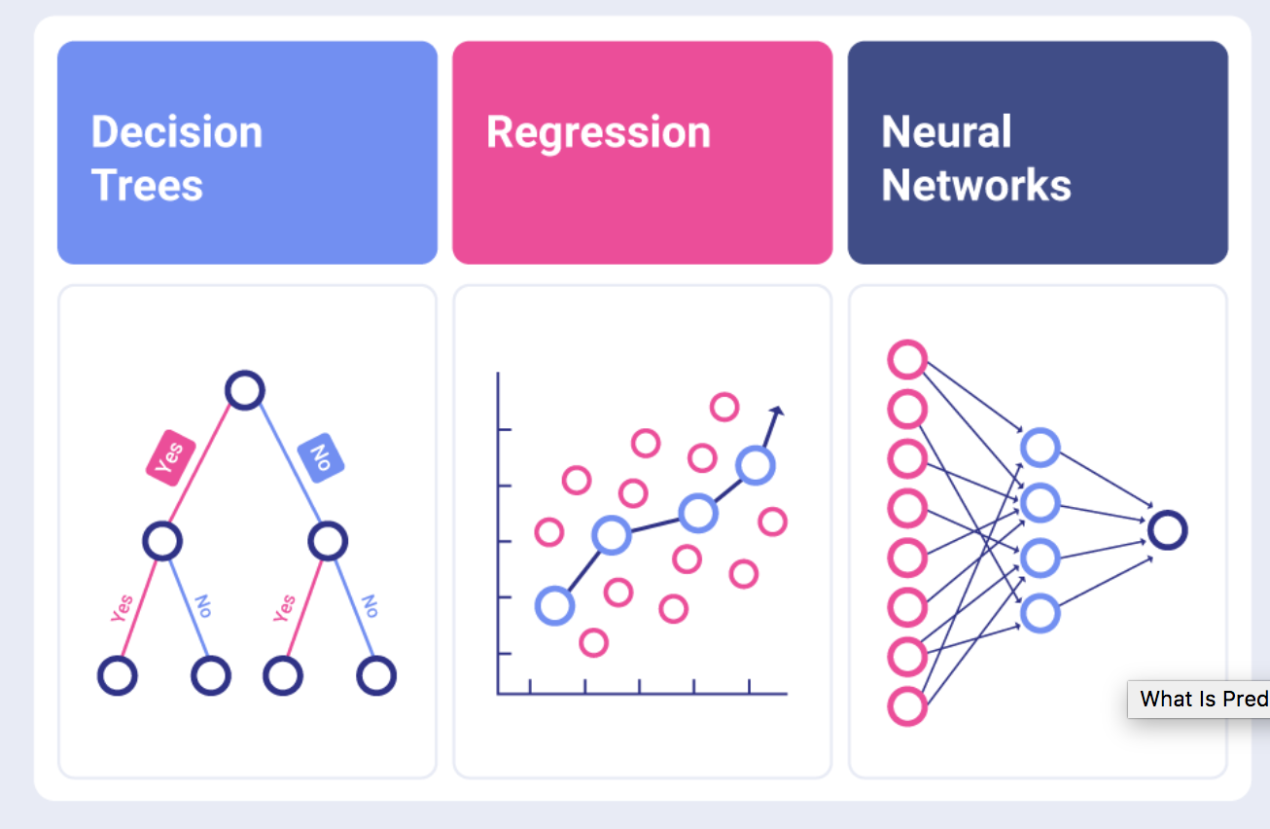
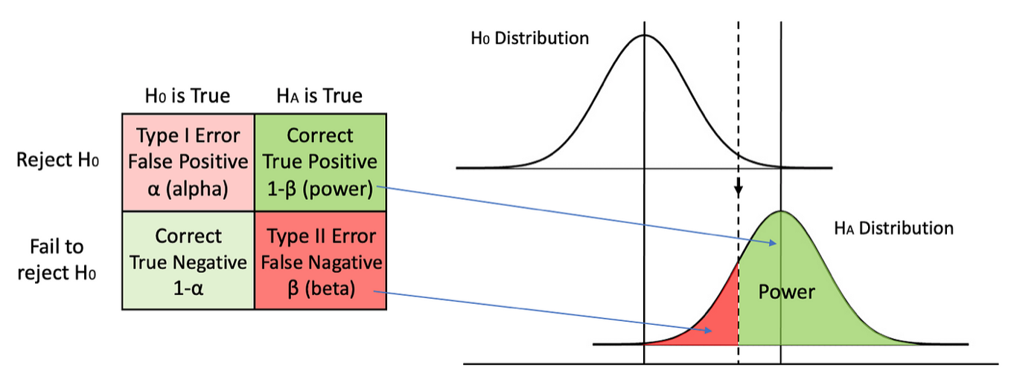
Positives of classical statistics
Provides powerful, all-purpose tools.
Notes:
https://www.slingshotapp.io/blog/predictive-analytics
https://towardsdatascience.com/5-ways-to-increase-statistical-power-377c00dd0214
Treating causation as a limiting (but unknowable) case of correlation has resulted in the magnificent, ornate edifice of modern statistics. It has resulted in Machine learning methods, and ways to quantify uncertainty (and calculate Power etc)

Slide 7

Positives of classical statistics
Provides powerful, all-purpose tools.
Grounds scientific thinking in skepticism.
What can we know? Only data; agnostic
How can we know it? Only RCT (or A/B testing)
Notes:
https://www.slingshotapp.io/blog/predictive-analytics
https://towardsdatascience.com/5-ways-to-increase-statistical-power-377c00dd0214
2. When we are studying a phenomenon, we often really really want the answer to support our pet hypothesis. This epistemological framework forces us to be more honest and override our innate desire to be right.

Slide 8
Drawbacks of classical statistics
Patterns in data can result from multiple, distinct factors that can’t be differentiated (e.g., confounding variables).
Notes:
https://hdsr.mitpress.mit.edu/pub/da99kl2q/release/3
* Confounding variables are difficult to adjust for in classical statistics. More problematically, sometimes we should adjust for them and sometimes we shouldn’t!

Slide 9
Drawbacks of classical statistics
Patterns in data can result from multiple, distinct factors that can’t be differentiated (e.g., confounding variables).
Implied causality models
Notes:
https://hdsr.mitpress.mit.edu/pub/da99kl2q/release/3
There often is an implied model of relationships in our mental map --- we just aren’t always “allowed” to be overt about what goes into those models!
I don’t know enough about this topic anymore, but this is a foundational problem with developing true Artificial Intelligence (or, at least, I have read that… Judea Pearl and others).

Slide 10
Drawbacks of classical statistics
Patterns in data can result from multiple, distinct factors that can’t be differentiated (e.g., confounding variables).
Implied causality models
Limited ability to handle mixture of qualitative + quantitative data
Notes:
https://hdsr.mitpress.mit.edu/pub/da99kl2q/release/3
We must be able to handle ‘modern’ observational datasets which are heterogeneous, missing data, large data sets with LOTS of information.

Slide 11
Drawbacks of classical statistics
Patterns in data can result from multiple, distinct factors that can’t be differentiated (e.g., confounding variables).
Implied causality models
Limited ability to handle mixture of qualitative + quantitative data
Unintuitive: What is a p-value, anyway?
Notes:
https://hdsr.mitpress.mit.edu/pub/da99kl2q/release/3
Not intuitive

Slide 12
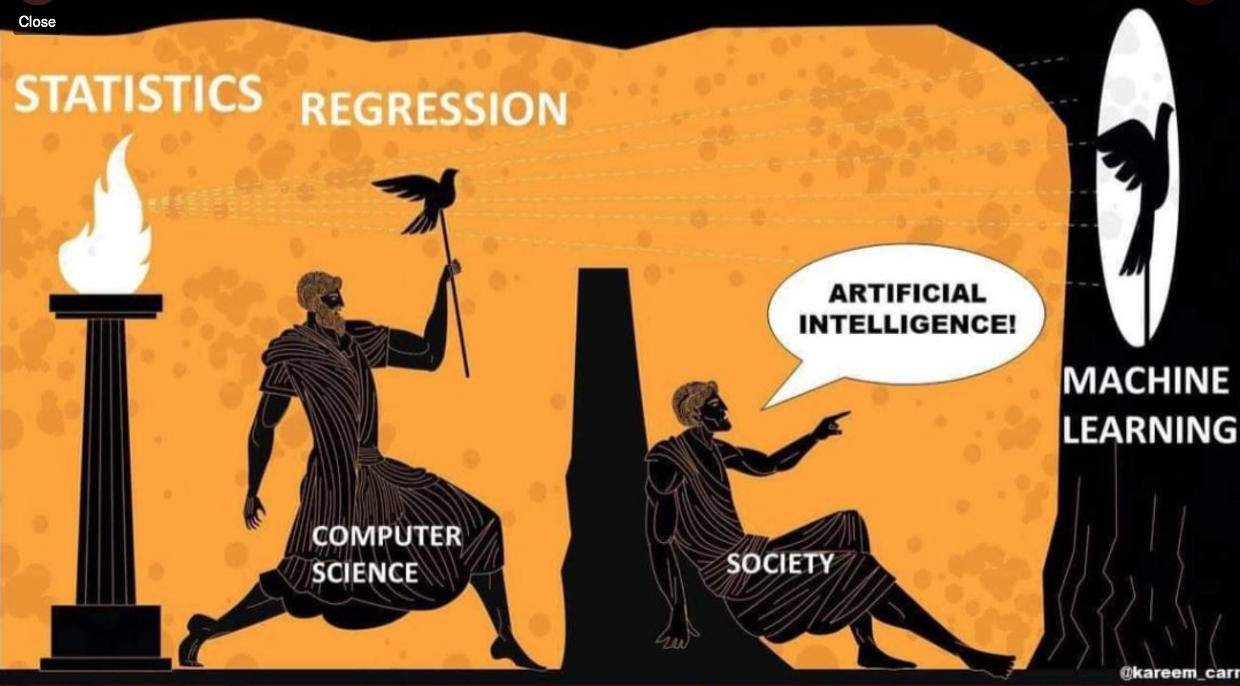
Drawbacks of classical statistics
Patterns in data can result from multiple, distinct factors that can’t be differentiated (e.g., confounding variables).
Implied causality models
Limited ability to handle mixture of qualitative + quantitative data
Unintuitive: What is a p-value, anyway?
Lack of transparency in some modern methods (e.g., machine learning, AI, etc.).
Interpretability & replicability
Bias & fairness
Notes:
https://hdsr.mitpress.mit.edu/pub/da99kl2q/release/3
If we can’t see “under the hood” so we don’t always know where the bias is.
(I can hear the chorus of ML experts chiming in with complaints that they do a LOT of testing and have other guard rails in the process, but there have been wide spread examples of bias from everything from google searches and facial recognition software to medical examples. You don’t always know the bias that you – or your peers – are bringing to the datasets in a project and it isn’t always overt)
Much like incorporating Bayesian training into classical statistical training, we could incorporate causal thinking (counterfactuals, “do” calculus, and… of course… Casual Diagrams)

Slide 13

Fantastical Paradoxes and How to Slay Them
 | Control (No Drug D) |  | Treatment (Drug D)
 | Heart Attack | No Heart Attack | Heart Attack | No Heart Attack | Control | Treatment (D)
Female | 1 | 19 | 3 | 37 | 5% | 7.5%
Male | 12 | 28 | 8 | 12 | 30% | 40%
Total | 13 | 47 | 11 | 49 | 22% | 18%
Did Drug D decrease the percentage of heart attacks?
These three statements are all true according to the above data:
Drug D increases Prob(HA) in females
Drug D increases Prob(HA) in males
Drug D decreases Prob(HA) in entire population
Notes:
Simpson’s paradox. BBG.

Slide 14
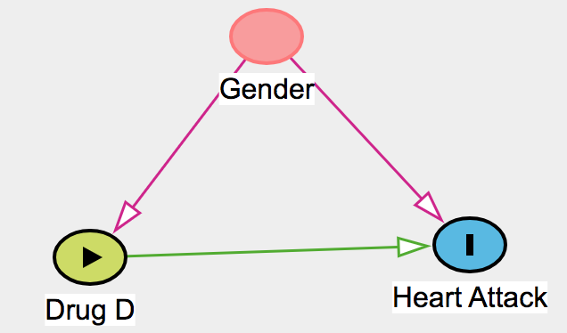
Case 1: Confounders
 | Control (No Drug D) |  | Treatment (Drug D)
 | HA | No HA | HA | No HA | Con. | Treat (D)
Female | 1 | 19 | 3 | 37 | 5% | 7.5%
Male | 12 | 28 | 8 | 12 | 30% | 40%
Total | 13 | 47 | 11 | 49 | 22% | 18%
Did Drug D decrease the percentage of heart attacks?
These three statements are all true according to the data:
Drug increases Prob(HA) in females (Bad)
Drug increases Prob (HA) in males (Bad)
Drug decreases Prob(HA) in entire population (Good)
Notes:
Simpson’s paradox: Introducing CAUSAL Diagrams.
When you draw out a causal diagram, you can immediately see that gender is a confounder. This means that if you want to Interrogate if Drug D effects Prob(HA), you need to adjust for gender (STRATIFY) and close the ‘backdoor path’. You can think of this as: picking one gender means that all the individuals who are assessed are homogenous (they belong to one gender) and this removes the confounder bias.
Conditioning: Conditioning on a variable means using either sample restriction, stratification, adjustment or matching to examine the association of A & Y within levels of the conditioned variable.

Slide 15
Case 2
 | Control (No Drug B) |  | Treatment (Drug B)
 | Heart Attack | No Heart Attack | Heart Attack | No Heart Attack | Control | Treatment (D)
Low Blood Pressure | 1 | 19 | 3 | 37 | 5% | 7.5%
High Blood Pressure | 12 | 28 | 8 | 12 | 30% | 40%
Total | 13 | 47 | 11 | 49 | 22% | 18%
Did Drug B decrease the percentage of heart attacks?
How would you analyze the data?
The suspected mechanism of Drug B is through Blood Pressure
Blood pressure is stable once measured
Notes:
Simpson’s paradox. BBG.

Slide 16
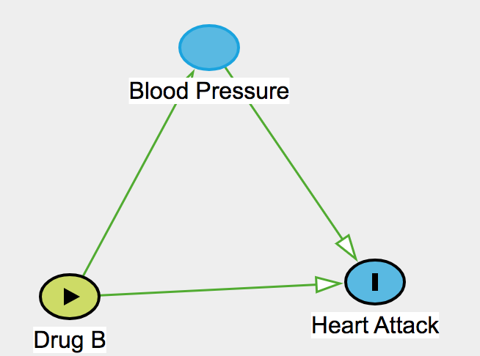
Case 2: Mediators
 | Control (No Drug B) |  | Treatment (Drug B)
 | HA | No HA | HA | No HA | Con. | Treat (D)
Low BP | 1 | 19 | 3 | 37 | 5% | 7.5%
High BP | 12 | 28 | 8 | 12 | 30% | 40%
Total | 13 | 47 | 11 | 49 | 22% | 18%
Did Drug B decrease the percentage of heart attacks?
These three statements are all true according to the data:
Drug increases Prob(HA) in high BP (Bad)
Drug increases Prob(HA) in low BP (Bad)
Drug decreases Prob(HA) in entire population (Good)
Notes:
Simpson’s paradox: When you draw out a causal diagram, you can immediately see that blood pressure is a MEDIATOR. You cannot treat it the same way in analysis as you did the confounder (gender). In fact, if you ADJUST (Stratify) for it, you will be blocking a path (disabling) a path that Drug B USES to reduce Heart Attack. SO: Aggregate data is used!
Mediator: a variable within the causal pathway between the treatment and outcome. Treatment (A) influences the mediator, which in turn influences the outcome.

Slide 17
Case 3
 | Control (No Drug ) |  | Treatment (Drug C)
 | Heart Attack | No Heart Attack | Heart Attack | No Heart Attack | Control | Treatment (D)
Weight Loss | 1 | 19 | 3 | 37 | 5% | 7.5%
No Weight Loss | 12 | 28 | 8 | 12 | 30% | 40%
Total | 13 | 47 | 11 | 49 | 22% | 18%
Did Drug C decrease the percentage of heart attacks?
Drug C can cause weight loss (> 5kg) in patients.
Being hospitalized for a heart attack can also lead to weight loss.
Notes:
Simpson’s paradox. BBG.

Slide 18
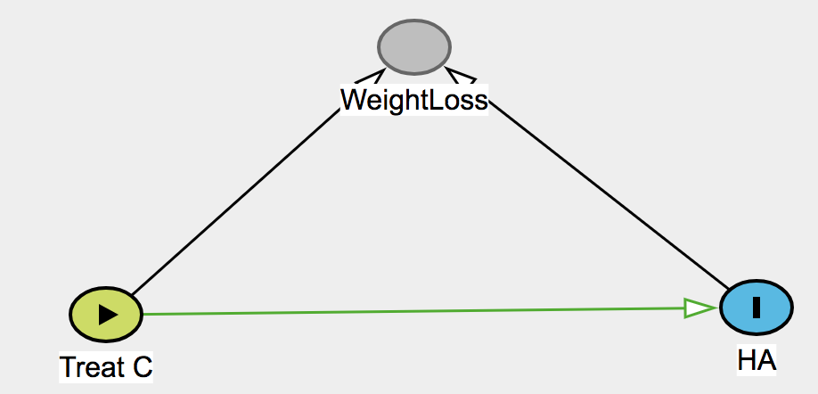
Case 3: Colliders
 | Control (No Drug C) |  | Treatment (Drug C)
 | HA | No HA | HA | No HA | Con. | Treat (D)
Weight loss | 1 | 19 | 3 | 37 | 5% | 7.5%
No Weight loss | 12 | 28 | 8 | 12 | 30% | 40%
Total | 13 | 47 | 11 | 49 | 22% | 18%
Did Drug C decrease the percentage of heart attacks?
These three statements are all true according to the data:
Drug increases Prob(HA) in Weight loss group (B)
Drug increases Prob(HA) in No Weight Loss group (B)
Drug decreases Prob(HA) in entire population (G)
Notes:
Collider bias: In this case, it is possible that Treatment C impacts weight loss and, independently, hospitalization due to a heart attack also impacts weight loss. C and HA are independent causes of weight loss. This is a bit of a manufactured example, but you can see that Weight loss is a collider so you don’t want to condition on it (or adjust for it) since that “opens the path” and creates a false correlation between treatment C and Heart Attack hospitalization.
Gas→ Car starts/doesn’t start ←battery dead if you condition on the car not starting and know that there is no gas, you know that there is a broken engine
Collider bias results from:
Restriction on a collider (e.g., by selective study participation)
Stratifying the analysis on the collider;
Adjusting for a collider in a regression model.
-------------------------------------------------
Collider bias is present in: Selection Bias (Berkson’s Bias) a particular type of collider bias in which the common effect is selection into the study; occurs when a common effect is conditioned such that there is now a conditional association between A & Y (e.g. Berkson's Bias, loss to f/u, missing data, healthy worker bias)

Slide 19
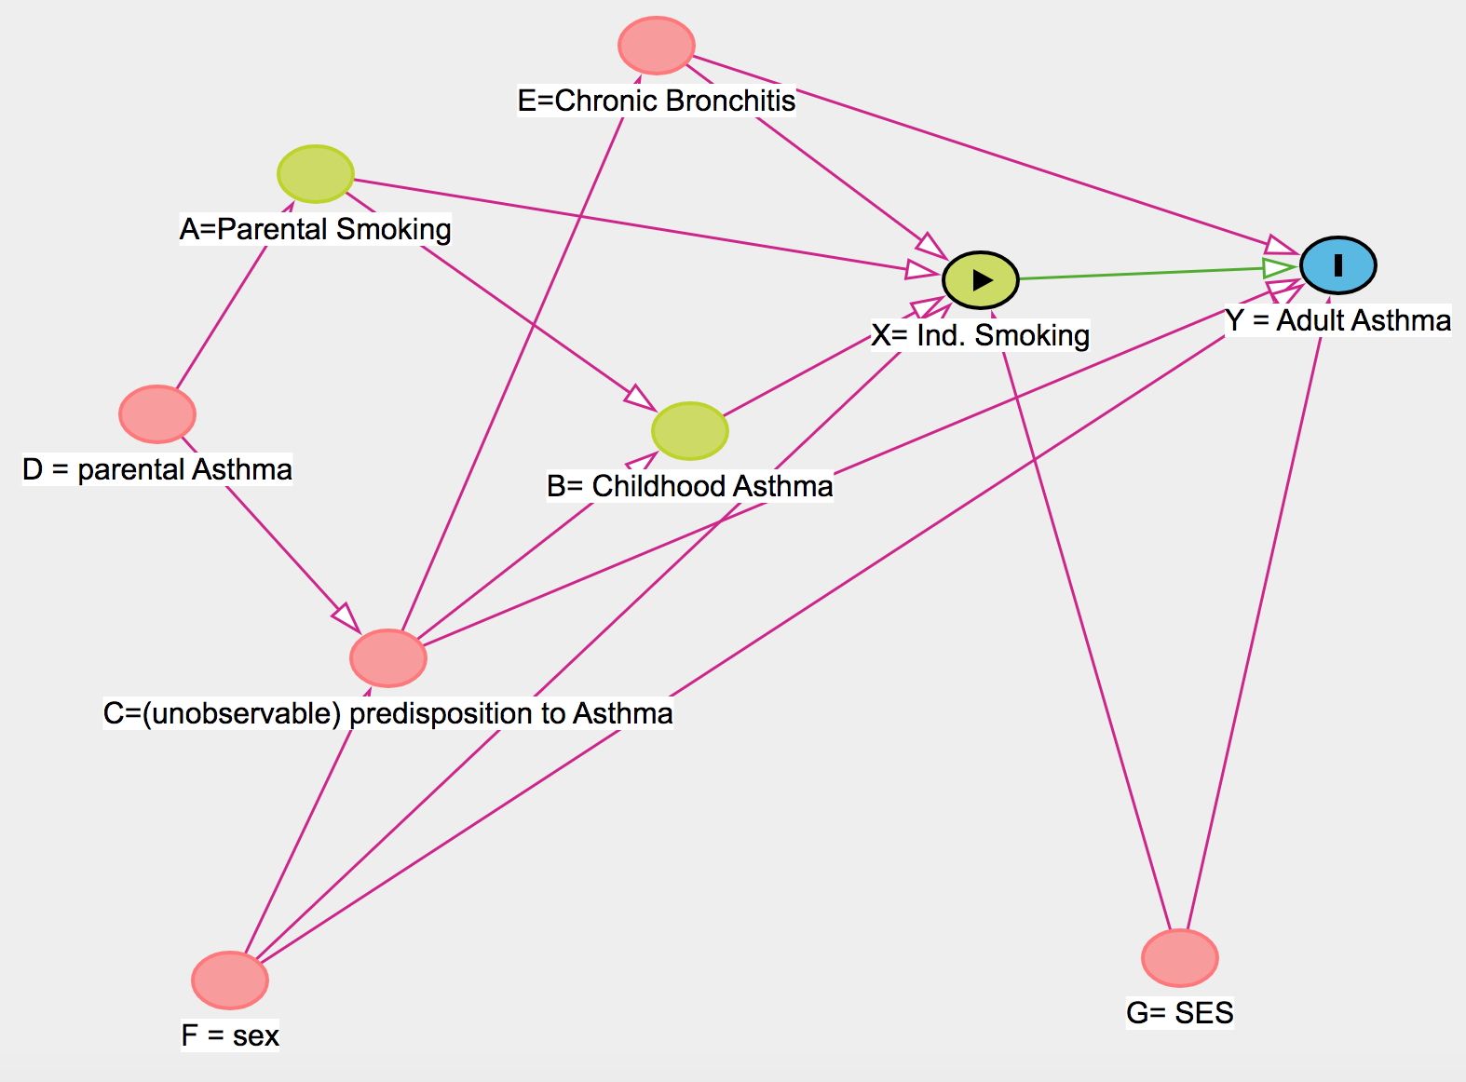
Williamson et al, 2014
Notes:
It is really tough to analyze this (fairly simple) network using classical methods. But Causal Diagrams allows you to easily do it (and spoiler: we’re going to see software that makes it REALLY easy to identify which nodes are confounders – and need to be adjusted for – and which are colliders and should NOT be adjusted for)
Elizabeth Williamson et al, 2014. model of smoking and asthma
Model gets complex quickly.
E, F, G must be controlled for (but not D!) so a sufficient set of variables for deconfounding is: A, B, E, F, G

Slide 20
Directed Acyclic Graphs (DAGs)
What are they?
Causal diagrams depict causal relationships between treatment (exposure), result (outcome), and covariates (confounders).
A TRUE casual structure exists, but we may not know it
Part of ecosystem of casual analysis, including do calculus (interventions)
Some basic notation & diagram rules, i.e. Arrows point from cause to effect in one direction only
Notes:
Conditional exchangeability: an assumption of the equivalent distribution of values outside of the treatment effect (two subject only vary in outcome due to assigned treatment)
Allow us to determine which variables need to be adjusted for and which don’t to obtain unbiased estimate: adjustment set of variables that has conditional exchangeability
Confounder selection, accounting for selection bias, measurement error, instrumental variable selection
In a nutshell, a DAG is a graphic model that depicts a set of hypotheses about the causal process that generates a set of variables of interest.
any set of covariates that closes all biasing paths (and does not open new ones or closes causal paths in the process) is called an adjustment sets.
Which Variables Should be Included?
• All common causes of any 2 variables in the DAG
• Unmeasured (and unmeasurable) common causes
• Selection variables, i.e. inclusion criteria
VERY good figure here: https://www.ncbi.nlm.nih.gov/pmc/articles/PMC8821727/figure/F1/

Slide 21
Directed Acyclic Graphs (DAGs)
What are they?
Causal diagrams depict causal relationships between treatment (exposure), result (outcome), and covariates (confounders).
A TRUE casual structure exists, but we may not know it
Part of ecosystem of casual analysis, including do calculus (interventions)
Benefits:
Clarifies model assumptions
Identifies and differentiates confounders, mediators, and colliders
Determine which variables need adjustment to obtain an unbiased estimate
Allows comparison of statistical associations in competing causal models to assess compatibility with data → alternate DAGS can be assessed for sensitivity analysis, etc.
Drawbacks:
Multidisciplinary expertise is required since they incorporate all available evidence
Some information types are not available, i.e. effect sizes
Notes:
Conditional exchangeability: an assumption of the equivalent distribution of values outside of the treatment effect (two subject only vary in outcome due to assigned treatment)
Allow us to determine which variables need to be adjusted for and which don’t to obtain unbiased estimate: adjustment set of variables that has conditional exchangeability
Confounder selection, accounting for selection bias, measurement error, instrumental variable selection

Slide 22
The Rules of Causal Diagrams and Relationships
(According to Judea Pearl)
Name | Variable Configuration | Response and Impact
1. The Confounder | A← B → C | Controlling for B prevents information flowing between A and C so they become conditionally independent (closes path)
2. The Pipe | A→ B → C | Controlling for B prevents information about A getting to C so they become conditionally independent (closes path)
3. The Collider | A→ B← C | Controlling for B forces A and C to BECOME dependent (opens path): Collider Bias
Notes:
D-separation Rules: Thus if two variables are d-separated relative to a set of variables Z in a directed graph, then they are independent conditional on Z in all probability distributions such a graph can represent. Roughly, two variables X and Y are independent conditional on Z if knowledge about X gives you no extra information about Y once you have knowledge of Z. In other words, once you know Z, X adds nothing to what you know about Y.
D-separation (directional separation) criteria:
D-separated: all paths between two variables are closes; the variables are unassociated
D-connected: at least one path is open between two variables; they are at least partially associated.
Collider: This can also be made intuitive by considering what happens when you look at the relationship between two independent causes after you condition on a common effect. Consider an example given by Pearl (1988) in which there are two independent causes of your car refusing to start: having no gas and having a dead battery.
dead battery --> car won't start <-- no gas
-----------
Simpson’s paradox illustrates some limitations with traditional statistics. It was easy to resolve when you could draw out the causal elements in the system.
Judea Pearl has cultivated some basic rules for these diagrams (he has also put together do calculus for when diagrams are not sufficient).
You can’t just mindlessly turn a crank, but there are guidelines!
------------------------
Conditioning on a variable in an open backdoor path removes the non-causal association (i.e. controls for confounding)
Conditioning on a collider opens the path that the collider was blocking
Conditioning on a variable in the causal pathway (mediator) removes part of the causal effect

Slide 23
How to block communication between A and J?
A← B ← C → D ← E → F → G ← H → I → J
Any of the following strategies:
Control for B or F o r I (Mediator will close pipe)
Control for C or E or H (Confounder will close pipe)
DON’T Control for D or G (Collider will open pipe)
Control for nothing at all because it is already blocked
If you control for everything, you will unblock the path!
Notes:
With these three rules, we can get complex quickly.
Statisticians usually just want to adjust for everything ‘just to be safe’, but this can cause a big problem in analysis if you adjust for a collider.

Slide 24
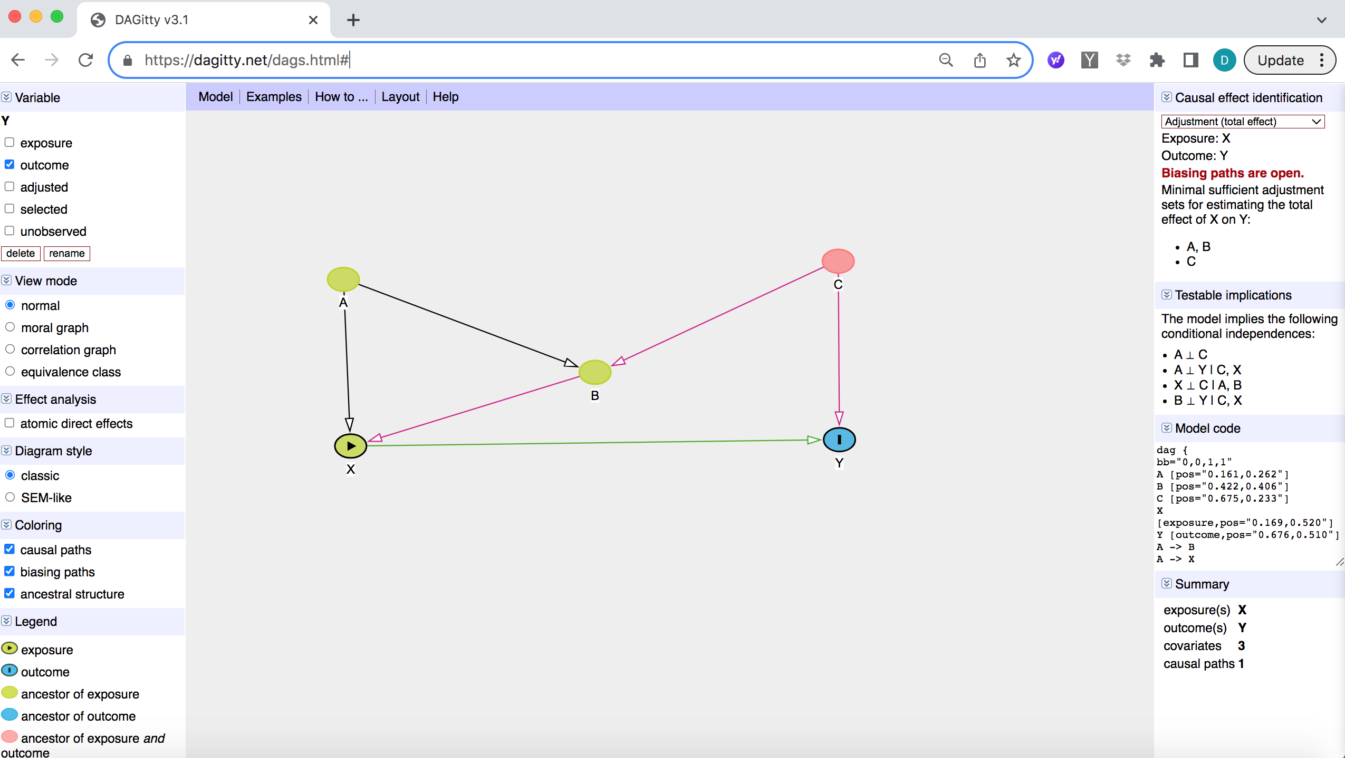

Slide 25
Notes:
Andrew Forbes and Elizabeth Williamson model of smoking and asthma
Model gets complex quickly.
E, F, G must be controlled for (but not D!) so a sufficient set of variables for deconfounding is: A, B, E, F, G

Slide 26
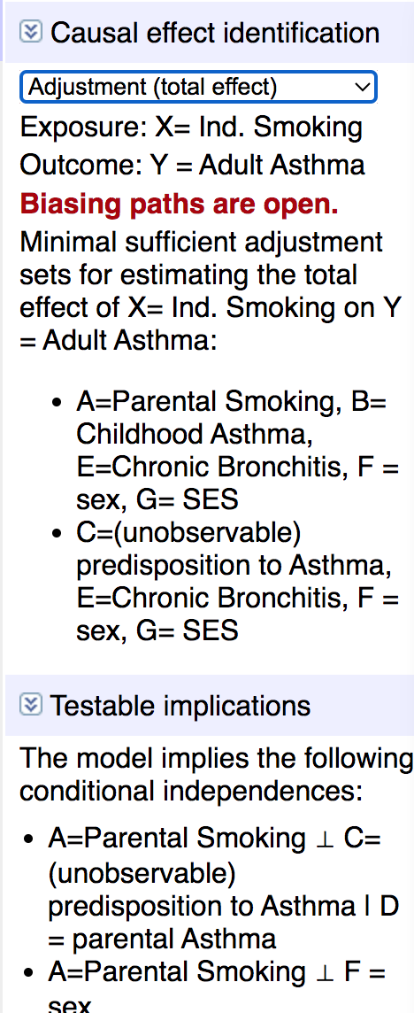
https://www.dagitty.net/
Notes:
Daggity gives you the sufficient set of defounders and testable implications (for conditional independence) and code and

Slide 27
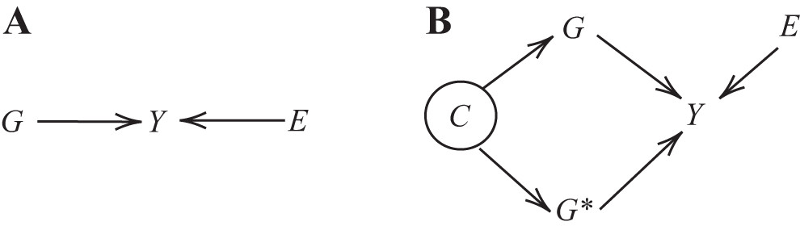
GWAS and Causal Diagrams
Fig. 3. Causal graphs for genome-wide association study (GWAS) analysis. A: graph shows the basic causal GWAS model, where the phenotype of interest, Y, is dependent on the gene of interest, G, and some other environmental factors, E. B: graph accounts for confounding by the ancestry of the individual, C, which affects the gene of interest, and the remaining genes, G∗. This modified graph assumes that a polygenic trait, Y, depends on both the gene of interest, and the remaining genes. By convention, unobserved (or latent) variables, such as the ancestry variable, C, are circled.
DOI: 10.1152/physiolgenomics.00115.2019

Slide 28
Additional Resources:
Hands on examples:
https://dagitty.net/learn/
Book:
“The Book of Why” (2018) Judea Pearl and Dana Mackenzie
Textbook:
“Statistical Rethinking” Richard McElreath (note: edition 3 soon)
Online Course:
https://github.com/rmcelreath/stat_rethinking_2023
Notes:
Additional: https://dagshub.com/blog/an-introduction-to-directed-acyclic-graphs-dags-for-data-scientists/

Slide 29
Notes:
Daggity gives you the sufficient set of defounders and testable implications (for conditional independence) and code and

Slide 30
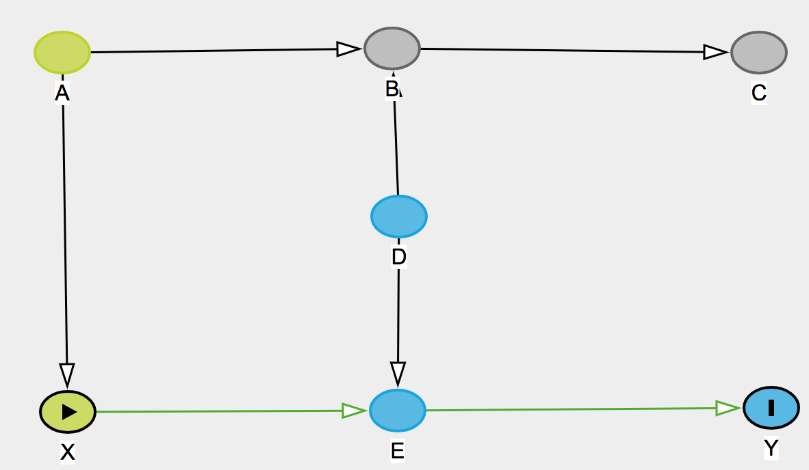
Notes:
Pretreatment variables are A, B, C, D
An example taken by Pearl from Clarice Weinberg
The example: A = did mother smoke during past pregnancy; X = Does mother smoke now (beginning of second pregnancy); B and E are underlying abnormalities caused by smoking (that can’t be observed) and D = other physiological causes of the abnormalities.
---------------------------
One backdoor path (arrows point into x): X←A→ B ←D → E→Y but there is a collider at B which already blocks the path!
If you conditioned on B or C, you would open the backdoor (noncausal) path between X and Y and therefore confound X and Y. (You could reclose the path by conditioning on D and or A)

Slide 31
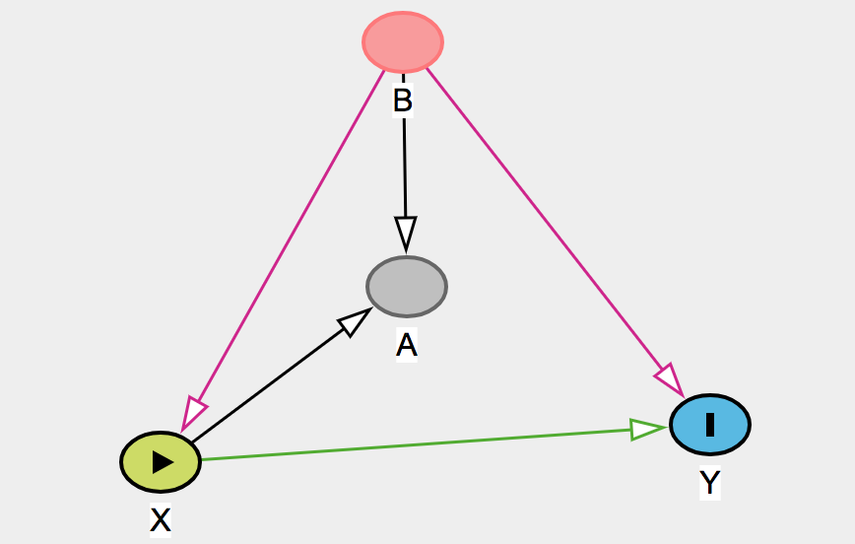
Notes:
There is a backdoor path (noncausal path): X←B→Y This can be closed by conditioning on B. If you cannot condition on B (it is unobservable), you will need to run RCT. DO NOT CONDITION ON A (proxy of B) because this will introduce collider bias!

Slide 32
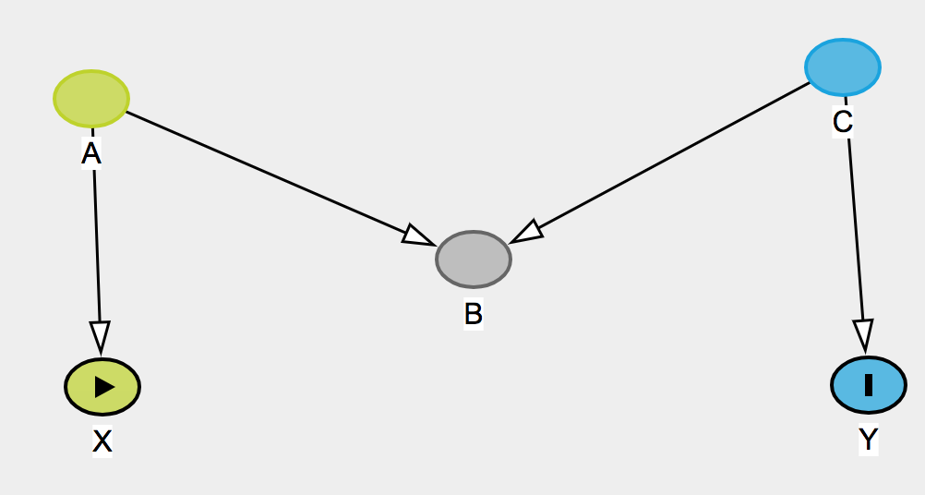
Notes:
M-Bias path.
Only one backdoor path and it is blocked by collider at B.
Traditional statisticians would consider B a confounder but it isn’t! It would be disasterous to analyze it as though it was a confounder.
You can control for B if you also control for A or C.
---------
Andrew Forbes and Elizabeth Williamson
X = individual’s smoking behaviour
Y = person has asthma as adult
B= childhood asthma
A=parental smoking
C=underlying (and unobservable) predisposition to smoking

Slide 33
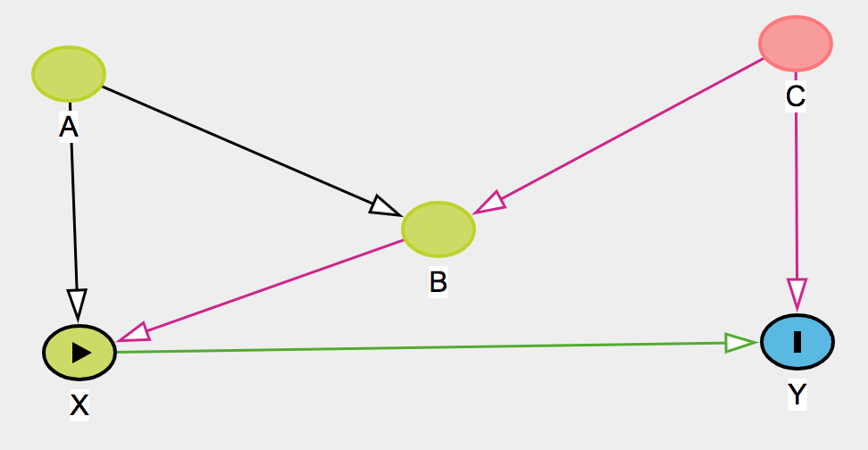
Notes:
M-Bias path plus a wrinkle!
Backdoor path via collider B
New backdoor path: X ←B←C→Y which must be closed. If we close it via B, we open the other path because B is a collider (we could then also control for A or C to close it), We could also close it via C.

